Slide 1
v
Viatech

Slide 2
Info
project for GlobalLogic
webshop with electronic products
product owner: Martin Tarhanič

Slide 3
Viatech is an ecommerce website solution focused on minimalist design while still packing features such as detailed product filter, user statistics, modern feel and 3-button checkout all bundled in a friendly user experience package able to compete in the market with similar sites at ease.

Slide 4
Project
Frontend
Server
Database
Dominik Kolesár
Matúš Kačmár
Matúš Kokoška
Tomáš Paronai
Gergely Siladi
Peter Varhoľák

Slide 5
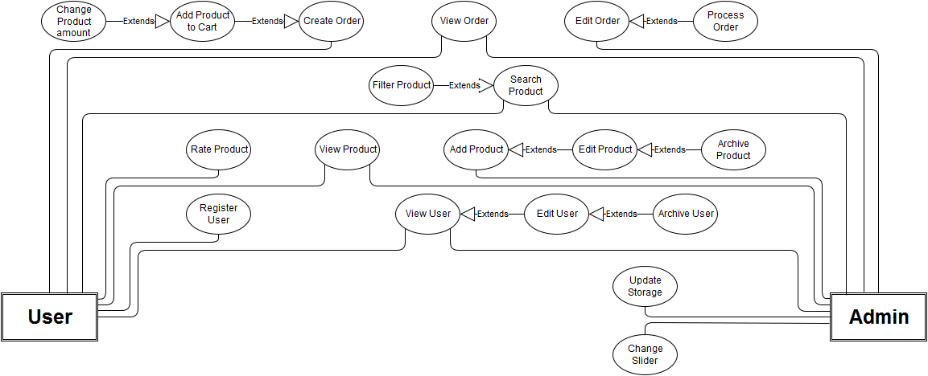
UML

Slide 6
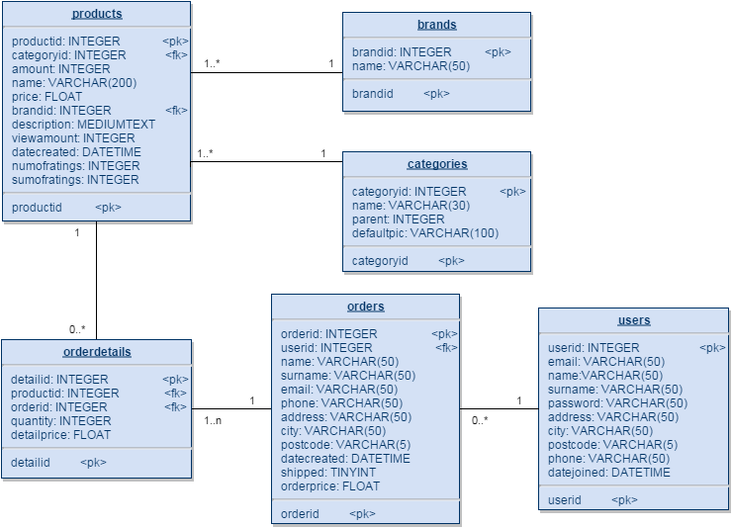
LDM
PDM

